Slide 1


Taking DSD to Scale in Zimbabwe
Differentiated Service Delivery 2018: Innovations, Best Practices & Lessons Learned
Dr. Tsitsi Apollo
Deputy Director HIV/AIDS, STIs
Zimbabwe, MOHCC,
July 23, 2018

Slide 2

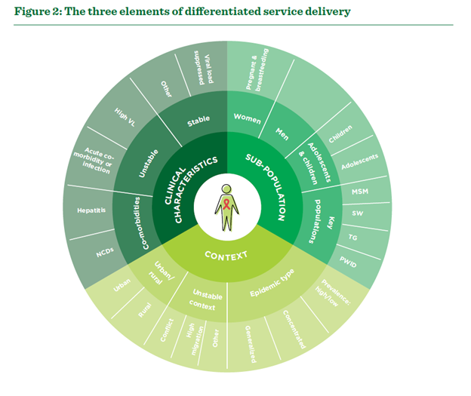
Outline:
Country Context
Approaches to scaling up DSDs
Lessons Learnt

Slide 3
Country Context
Zimbabwe has a generalized HIV epidemic
Total population: 13.5 million (Census 2012)
Total PLHIV: 1,32 m (76,653 children) [2017 Estimates]
  Males 41%
  Females 59%
HIV Prevalence: 14,6% among 15-64 year age group
  Females: 16.7%; Males: 12.4%
HIV Incidence: 0.45% in 2016
New Infections: 40, 973 per year (2017 HIV Estimates)
Viral Suppression among people on ART: 86.5% [ZIMPHIA, 2015/16]
MTCT rate 5,2% at end of breast-feeding period
TB/HIV co-infectivity rate 72%
DSD Implementation success noted in 2017 with scale up earmarked for 2018-2019

Slide 4
Approaches to DSD Review Meetings
Combined Review Meeting for Quality Improvement, Mentorship and DSD - Feb, 2018
Targeted provincial and district mentors
Provincial DSD Review Meeting, Kadoma - May, 2018
Targeted district health teams that had been involved with implementation since the roll-out of DSD guidance in 2017
Oriented health workers on a simple DSD baseline data collecting tool
Targeted Provincial Health Teams & partners
A dedicated DSD session within a scheduled annual HIV and TB Review meeting
Sensitization of health workers on DSDMs
National Annual Planning & Review for HIV and TB, Bulawayo- Nov, 2017
Targeted HCWs leading quality improvement teams in health facilities – mainly nurses
Peer platform for experience sharing, identification of bottlenecks and development for strategies for further implementation
140 nurses from 105 facilities reached
Sensitization done on DSDs, quick assessment made on progress
Orientation on mentorship, DSD and QI and development of implementation plans
Presentations made on provincial baseline data using the tool from the Annual Review Meeting
120 mentors and managers reached
57 provincial HCWs from 28 health facilities reached
Peer platform for sharing of implementation progress, best practices and identification of gaps to be addressed
DSD Reviews Integrated with QI quarterly Review meetings, Oct 2017
and provincial plans developed

Slide 5
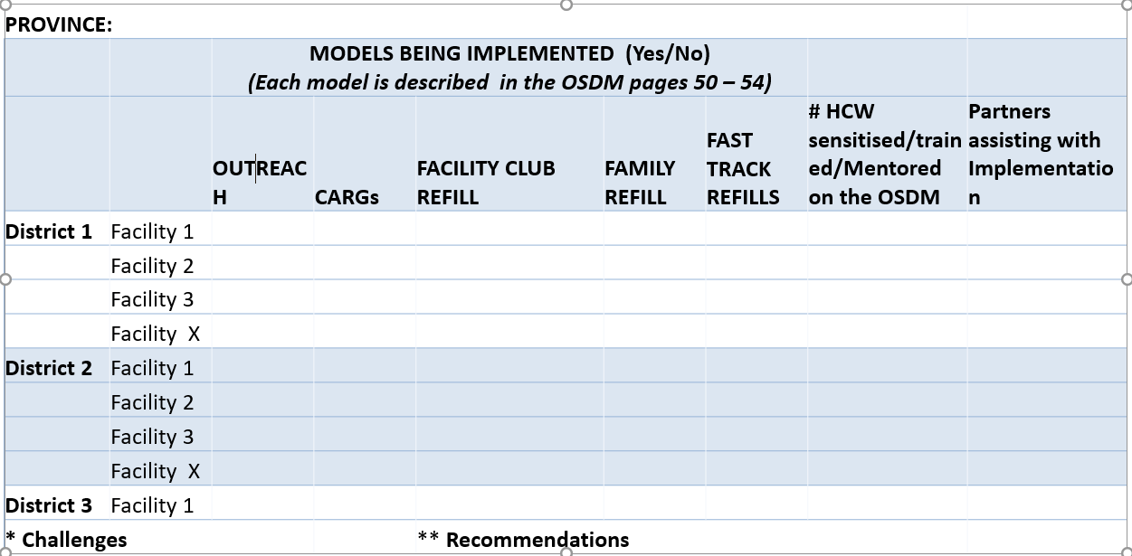
National Baseline Survey for DSDM
Designed a simple tool for the baseline DSD survey in November 2017
Oriented health workers on how to fill the template during the National Annual TB and HIV Review and Planning Meeting
Provincial Teams provided feedback on survey data during the National Mentor’s technical Update Meeting in February, 2018

Slide 6
Proportion of Districts that have at least one facility implementing any one DSD ART Models, end of 2017
Notes:
The figure shows the proportion of districts that have at least one facility implementing any one of the DSD for ART models
All provinces seem to be implementing to some extent however, implementation is not homogenous as shown in the few slides following

Slide 7



As countries scale up, some M and E systems have not yet been well adapted for DSD
Simpler ways of collecting reliable data needed: Simple sample based method for period monitoring
DSD Scale Up
Reliable DSD Data to Inform Programming
The Missing link : Robust M and E Systems
Notes:
As countries scale up, some M and E systems have not yet been well adapted for DSD
But data needed to inform program
Simpler ways of collecting reliable data needed
Simple sample based method for periodic monitoring of DSD implementation was designed with the assistance of CQUIN
This was piloted/done in Mashonaland West Zimbabwe for the DSD review meeting

Slide 8
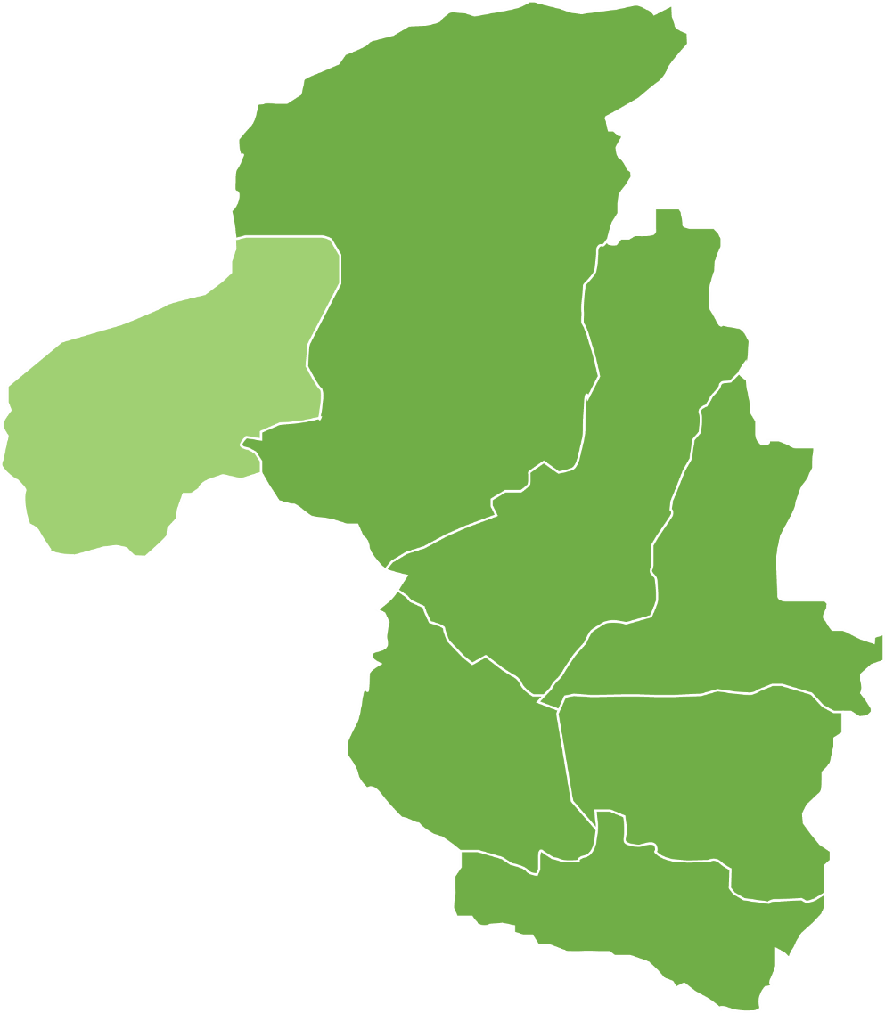
Mashonaland West Province
Total Catchment Population 1,594,038
Total Clients on ART 131,858
  Adults 124,244
  Children 7,614
6/7 Districts Currently Implementing DSDs
30 (16.7%) facilities sampled from the 6 districts
14%
Hurungwe
Kariba
Makonde
Zvimba
Sanyati
Chegutu
Mhondoro
Ngezi
Notes:
The province has 7 districts, six of which started implementing the Treat All and DSD guidance last year, 2017
Because of time constraints to the review only 5 facilities per district were sampled for the review. This is 16.7% of all facilities (total 30)

Slide 9
Methodology
Step 1: Identified Indicators And Data Needed
Information needed on Coverage, Uptake and Retention
Step 2: Developed Basic Data Abstraction Form
Data Collection Tool developed
Step 3: Selected Facilities
One province selected; All implementing districts sampled
11 indicators identified
10 data elements derived for analysis
Simple Yes/ No responses or Options given to choose from
One district Hospital, two high volume facilities and two low volume facilities
Random selection
Notes:
Step 3: High volume facilities had >1000 clients in care

Slide 10
Methodology
Step 4: Selected Clients
Clients selected in 2 cohorts
12 month cohort [initiated Feb 2017]
Step 5: Abstracted Data
Excel Data abstraction form developed
Step 6 & 7: Create Simple Summaries, Share and Utilize Data
Analysis: Frequencies and proportions for districts and facility generated using Excel
Information shared and discussed, used to inform scale up
24 month cohort [initiated Feb 2016]
10 questions; Simple Yes/ No, drop down option responses
4 weeks data collection, coordinated by Provincial & District Focal Persons

Slide 11
Mashonaland West Province as of April, 2018
Notes:
The sampling exercise showed that for the cohorts analysed for, all districts had were largely implementing the Fast Track, CARGs and Family Refills

Slide 12
Mashonaland West
Provincial DSD Data Summary as of April, 2018
N=176
N=22
N=44
N=20
*For adult clients active on ART (not controlled for stability criteria)
Notes:
Slide shows the data for both the 12 months and 24 months cohorts combined. Hurungwe (the learning district in the province) had extensive Implementation of the Fast Track, club refills and CARG models

Slide 13
Mashonaland West
Provincial DSD Data Summary as of April, 2018
Total ART Clients by Cohort
24 Month Cohort=375
12 Month Cohort=729
*For adult clients active on ART (not controlled for stability criteria)
Notes:
This graph controls for clients active on ART (seen for clinic visit or ART pickup within last 3 months)

Slide 14
Modified DSD Cascade by Cohort*†
30% of Active on ART
21% of Active on ART
*For adult clients
†Excludes Makonde District due to ongoing data validation activities
**For all clients active on ART (not controlled for stability criteria)
Notes:
Adolescents aged 10-15 were excluded from all analyses due to small total client (n=25)
It is apparent from this modified cascade that the availability of VL testing is low (45% of active clients in the 24-month cohort and 32% in the 12-month cohort had received a VL test in the last 12 months). In this chart, we have not controlled the number of clients enrolled in non-mainstream models by VLS, due to the small number of clients with this test. In future provincial data review meetings, it may be worth collecting data on CD4, in order to obtain a more accurate picture of the adult population that meets the criteria of “stable” on ART (VL <1000 or CD >200, plus no opportunistic infection).
Only 21% of active ART patients in the 24-month cohort and 30% of active ART patients in the 12-month cohort were enrolled in a non-mainstream ART model.

Slide 15
Appropriateness of Model by Cohort and VLS*†
Inappropriate
Appropriate
Missed Opportunity
Appropriate
*For adult clients active on ART, where VLS is defined as a VL test ≤12 months ago and a result of <1000 copies
†Excludes Makonde District due to ongoing data validation activities
Notes:
This graph illustrates the “fidelity” of the system in enrolling clients in models appropriate for their VL status. Only VLS is used here, and may clients in the “No VLS + Non-Mainstream ART” are simply missing a VL result, but may meet the CD4 criteria for stability. Based on the Zimbabwe criteria for stability OI should also be assessed in order to determine eligibility for non-mainstream models, but this was not controlled for in the graph because we are not able to show stability here—only VL testing and results.

Slide 16
Lessons learnt
Integrated review meetings helped to leverage in-country resources; reaching wider audiences; helped to enhance program ownership; and fostered integrated DSD activities within broader HIV work plans
Sharing of practical implementation strategies and challenges among peers from similar settings helped to stimulate action towards scale up of DSDMs
Simple data collection tools and analyses can be used to develop capacity and interest for data utilization and track progress on DSD implementation while robust M and E systems are being set up
Stand-alone provincial review meeting provided more focused discussions and ample time for review of DSD implementation by district; however, may not be sustainable for scale up

Slide 17












Acknowledgements
Notes:
With this I would like to acknowledge all the ministry staff as well as all our partners who are helping making DSD possible in Zim. I thank you

